Slide 1
TIDE TIMES APP
Kabinesh Sakthivel : RA2311003011613
Aviral Acharya : RA2311003011614
Harshit Ranjan : RA2311003011615

Slide 2
PROBLEM STATEMENT
Coastal communities, sailors, surfers, and marine enthusiasts rely heavily on accurate tidal data to plan activities safely and efficiently. However, current tide prediction tools often lack real-time updates, personalized forecasting, and reliable predictions based on dynamic environmental factors such as weather, lunar cycles, and historical patterns. These limitations pose a challenge in ensuring optimal planning for various marine-related activities.
The existing tide prediction systems do not provide integrated platforms that combine user-friendly interfaces with advanced analytics for real-time and AI-driven tide forecasting. This leads to inefficiencies in safety planning, operational scheduling, and the potential for hazardous situations due to inaccurate or outdated information.

Slide 3
PROPOSED SOLUTION
Tide Times aims to address these challenges by offering a streamlined, SwiftUI-based iOS application that pulls tide data directly from the World Tide Times website, providing users with accurate, real-time tide predictions. The solution provides a comprehensive platform with the following key features:
Real-Time Data Integration: By leveraging the World Tide Times website for up-to-date tide data, Tide Timeswill ensure users always have access to the most accurate and current tidal information.
Location-Based Tide Predictions: The app will utilize geolocation technology to provide tide predictions based on the user's location, or users can manually search for specific coastal locations for tailored tide forecasts.
Weather Data Integration: The app will incorporate weather forecasts (wind speed, temperature, etc.) alongside tidal data, enabling users to get a complete picture of coastal conditions, helping them plan activities more efficiently.
Personalized User Dashboard: Users can save and track their favorite coastal locations. The app will provide personalized daily or weekly tide forecasts for those locations, ensuring users can plan their activities effectively.
Easy, User-Friendly Interface: Developed using SwiftUI, the app will have a modern, responsive interface that is intuitive and user-friendly, making it easy for all users, from novice to expert, to access vital tide information at their fingertips.

Slide 4
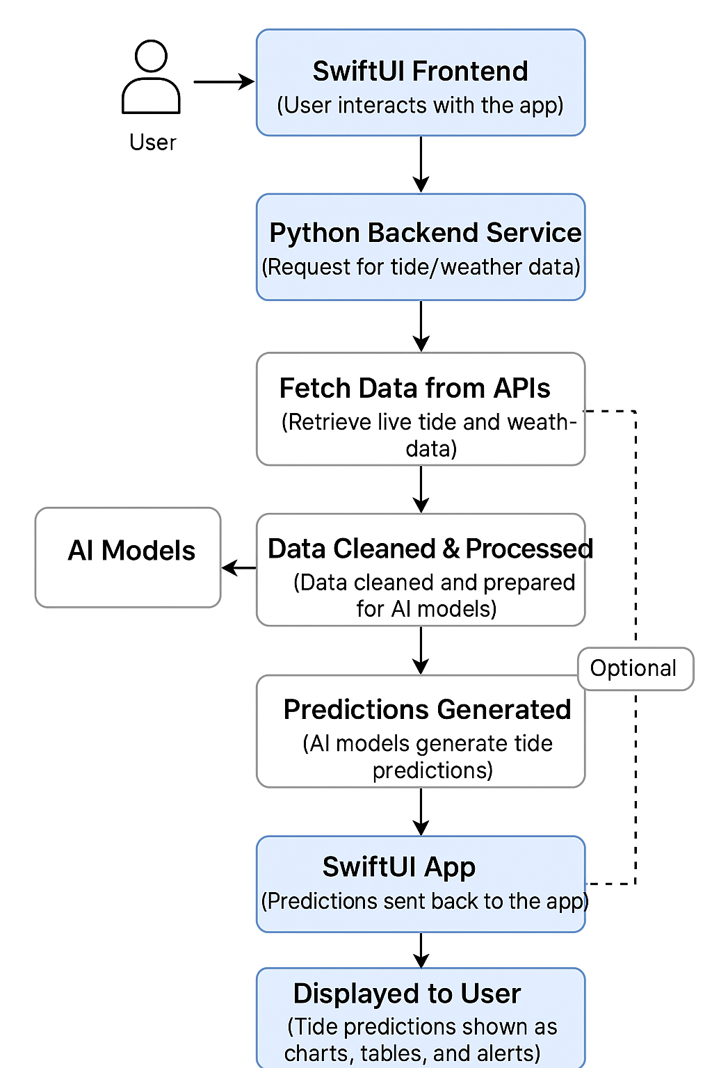
ARCHITECTURE DIAGRAM

Slide 5
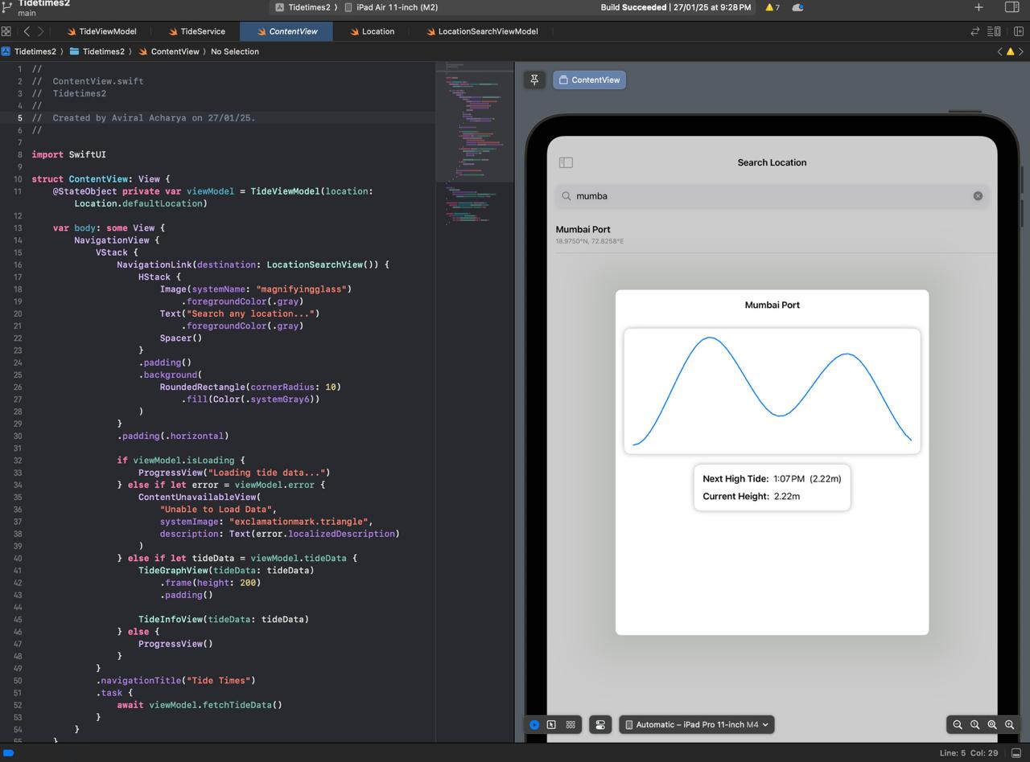
IMPLEMENTATION DETAILS

Slide 6
Tideview model
#if DEBUG
if ProcessInfo.processInfo.environment["XCODE_RUNNING_FOR_PREVIEWS"] == "1" || isPreview {
Task { @MainActor in
self.tideData = TideData.preview
}
}
#endif
}
func fetchTideData() async {
if isPreview { return }
isLoading = true
error = nil
do {
tideData = try await tideService.fetchTideData(
latitude: currentLocation.latitude,
longitude: currentLocation.longitude
)
} catch {
self.error = error
print("Error fetching tide data: \(error)")
}
isLoading = false
}
}
import Foundation
import SwiftUI
import CoreLocation
@MainActor
class TideViewModel: ObservableObject {
@Published var currentLocation: Location
@Published var tideData: TideData?
@Published var error: Error?
@Published var isLoading = false
private let tideService: TideService
private let isPreview: Bool
nonisolated init(location: Location = Location.defaultLocation, service: TideService = TideService(), isPreview: Bool = false) {
self._currentLocation = Published(initialValue: location)
self._tideData = Published(initialValue: nil)
self._error = Published(initialValue: nil)
self._isLoading = Published(initialValue: false)
self.tideService = service
self.isPreview = isPreview

Slide 7
Tide service
guard let url = urlComponents?.url else {
throw URLError(.badURL)
}
var request = URLRequest(url: url)
request.timeoutInterval = 30
do {
let (data, response) = try await URLSession.shared.data(for: request)
guard let httpResponse = response as? HTTPURLResponse else {
throw URLError(.badServerResponse)
}
switch httpResponse.statusCode {
case 200:
let worldTidesResponse = try JSONDecoder().decode(WorldTidesResponse.self, from: data)
let tideData = convertToTideData(worldTidesResponse)
cache[cacheKey] = (date: Date(), data: tideData)
return tideData
case 401:
throw NSError(domain: "TideService", code: 401,
userInfo: [NSLocalizedDescriptionKey: "Invalid API key. Please check your API key."])
case 403:
throw NSError(domain: "TideService", code: 403,
userInfo: [NSLocalizedDescriptionKey: "API quota exceeded. Please try again later."])
default:
if let errorResponse = try? JSONDecoder().decode(WorldTidesErrorResponse.self, from: data) {
throw NSError(domain: "TideService", code: httpResponse.statusCode,
userInfo: [NSLocalizedDescriptionKey: errorResponse.error])
}
throw NSError(domain: "TideService", code: httpResponse.statusCode,
userInfo: [NSLocalizedDescriptionKey: "Server error: \(httpResponse.statusCode)"])
}
} catch {
print("Network error: \(error)")
throw error
} }
}
// WorldTides API Response Models
private struct WorldTidesResponse: Codable {
let status: Int
let heights: [WorldTideHeight]
let extremes: [WorldTideExtreme]
}
private struct WorldTideHeight: Codable {
let dt: Int
let height: Double
}
private struct WorldTideExtreme: Codable {
let dt: Int
let height: Double
let type: String
}
// Add error response model for better error handling
private struct WorldTidesErrorResponse: Codable {
let error: String
}
import Foundation
class TideService {
// Free API from WorldTides.info
private let apiKey = "05add900-c08a-4881-9c52-1209378b6926"
// Get from https://www.worldtides.info/developer
private let baseURL = "https://www.worldtides.info/api/v3"
private var cache: [String: (date: Date, data: TideData)] = [:]
private let cacheValidityDuration: TimeInterval = 3600 // 1 hour
func fetchTideData(latitude: Double, longitude: Double) async throws -> TideData {
let cacheKey = "\(latitude),\(longitude)"
// Check cache first
if let cached = cache[cacheKey],
Date().timeIntervalSince(cached.date) < cacheValidityDuration {
return cached.data
}
var urlComponents = URLComponents(string: baseURL)
urlComponents?.queryItems = [
URLQueryItem(name: "heights", value: "true"),
URLQueryItem(name: "extremes", value: "true"),
URLQueryItem(name: "lat", value: String(format: "%.4f", latitude)),
URLQueryItem(name: "lon", value: String(format: "%.4f", longitude)),
URLQueryItem(name: "key", value: apiKey),
URLQueryItem(name: "days", value: "1")
]

Slide 8
content view
//
// ContentView.swift
// Tidetimes2
//
import SwiftUI
struct ContentView: View {
@StateObject private var viewModel = TideViewModel(location: Location.defaultLocation)
var body: some View {
NavigationView {
VStack {
NavigationLink(destination: LocationSearchView()) {
HStack {
Image(systemName: "magnifyingglass")
.foregroundColor(.gray)
Text("Search any location...")
.foregroundColor(.gray)
Spacer()
}
.padding()
.background(
RoundedRectangle(cornerRadius: 10)
.fill(Color(.systemGray6))
}
}
)
}
.padding(.horizontal)
if viewModel.isLoading {
ProgressView("Loading tide data...")
} else if let error = viewModel.error {
ContentUnavailableView(
"Unable to Load Data",
systemImage: "exclamationmark.triangle",
description: Text(error.localizedDescription)
)
} else if let tideData = viewModel.tideData {
TideGraphView(tideData: tideData)
.frame(height: 200)
.padding()
TideInfoView(tideData: tideData)
} else {
ProgressView()
}
}
.navigationTitle("Tide Times")
.task {
await viewModel.fetchTideData()
}
}
#Preview {
ContentView()
.preferredColorScheme(.light)
.environment(\.tideViewModel, TideViewModel(location: Location.defaultLocation, isPreview: true))
}
private struct TideViewModelKey: EnvironmentKey {
static let defaultValue = TideViewModel(location: Location.defaultLocation, isPreview: true)
}
extension EnvironmentValues {
var tideViewModel: TideViewModel {
get { self[TideViewModelKey.self] }
set { self[TideViewModelKey.self] = newValue }
}
}

Slide 9
Location searchview model
import Foundation
import MapKit
import Combine
@MainActor
class LocationSearchViewModel: NSObject, ObservableObject, MKLocalSearchCompleterDelegate {
@Published var searchQuery = ""
@Published var searchResults: [Location] = []
@Published var selectedLocation: Location?
// Add predefined Indian coastal locations
private let indianCoastalLocations = [
// Major Ports
Location(name: "Mumbai Port", latitude: 18.9750, longitude: 72.8258),
Location(name: "Chennai Port", latitude: 13.0827, longitude: 80.2707),
Location(name: "Kolkata Port", latitude: 22.5414, longitude: 88.3015),
Location(name: "Visakhapatnam Port", latitude: 17.6868, longitude: 83.2185),
Location(name: "Kochi Port", latitude: 9.9312, longitude: 76.2673),
// Minor Ports
Location(name: "Kandla Port", latitude: 23.0333, longitude: 70.2167),
Location(name: "Mangalore Port", latitude: 12.8698, longitude: 74.8431),
Location(name: "Tuticorin Port", latitude: 8.7642, longitude: 78.1348),
Location(name: "Paradip Port", latitude: 20.2937, longitude: 86.6708),
Location(name: "Ennore Port", latitude: 13.2611, longitude: 80.3339),
// Popular Beaches
Location(name: "Goa Calangute Beach", latitude: 15.5449, longitude: 73.7552),
Location(name: "Puri Beach", latitude: 19.8135, longitude: 85.8312),
Location(name: "Marina Beach Chennai", latitude: 13.0500, longitude: 80.2824),
Location(name: "Kovalam Beach", latitude: 8.3988, longitude: 76.9780),
Location(name: "Varkala Beach", latitude: 8.7378, longitude: 76.7163)
]
private let searchCompleter = MKLocalSearchCompleter()
private var cancellables = Set<AnyCancellable>()
override init() {
super.init()
searchCompleter.delegate = self
// Configure search for ports and coastal areas
if #available(iOS 13.0, *) {
searchCompleter.resultTypes = .pointOfInterest
var categories: [MKPointOfInterestCategory] = []
if #available(iOS 14.0, *) {
categories.append(contentsOf: [
.marina,
.beach
])
} else {
// For older iOS versions, use more general categories
categories.append(.marina)
}
let filter = MKPointOfInterestFilter(including: categories)
searchCompleter.pointOfInterestFilter = filter
}
// Debounce search query
$searchQuery
.debounce(for: .milliseconds(300), scheduler: RunLoop.main)
.sink { [weak self] query in
if !query.isEmpty {
self?.searchCompleter.queryFragment = query
self?.filterPredefinedLocations(query: query)
} else {
self?.searchResults = []
}
}
.store(in: &cancellables)
}
private func filterPredefinedLocations(query: String) {
let filteredLocations = indianCoastalLocations.filter { location in
location.name.lowercased().contains(query.lowercased())
}
searchResults = filteredLocations
}
func completerDidUpdateResults(_ completer: MKLocalSearchCompleter) {
Task {
var newLocations = completer.results
.filter { result in
let keywords = ["port", "harbor", "beach", "marina", "coast", "bay", "ocean", "sea"]
return keywords.contains { keyword in
result.title.lowercased().contains(keyword) ||
result.subtitle.lowercased().contains(keyword)

Slide 10
Location searchview model
// Update coordinates for non-predefined locations
for (index, result) in completer.results.enumerated() where index < newLocations.count {
let coordinate = await getCoordinate(for: result)
await MainActor.run {
if index < self.searchResults.count {
self.searchResults[index] = Location(
name: result.title,
latitude: coordinate.latitude,
longitude: coordinate.longitude
)
}
}
}
}
}
private func getCoordinate(for result: MKLocalSearchCompletion) async -> CLLocationCoordinate2D {
let searchRequest = MKLocalSearch.Request(completion: result)
let search = MKLocalSearch(request: searchRequest)
do {
let response = try await search.start()
return response.mapItems[0].placemark.coordinate
} catch {
print("Error getting coordinates: \(error)")
return CLLocationCoordinate2D()
}
}
}
}
}
.map { result in
Location(
name: result.title,
latitude: 0,
longitude: 0
)
}
// Combine with predefined locations
let filteredIndianLocations = indianCoastalLocations.filter { location in
location.name.lowercased().contains(searchQuery.lowercased())
}
newLocations.append(contentsOf: filteredIndianLocations)
// Remove duplicates based on name
let uniqueLocations = Array(Dictionary(grouping: newLocations) { $0.name }.values.map { $0[0] })
await MainActor.run {
self.searchResults = uniqueLocations
}

Slide 11
RESULTS

Slide 12
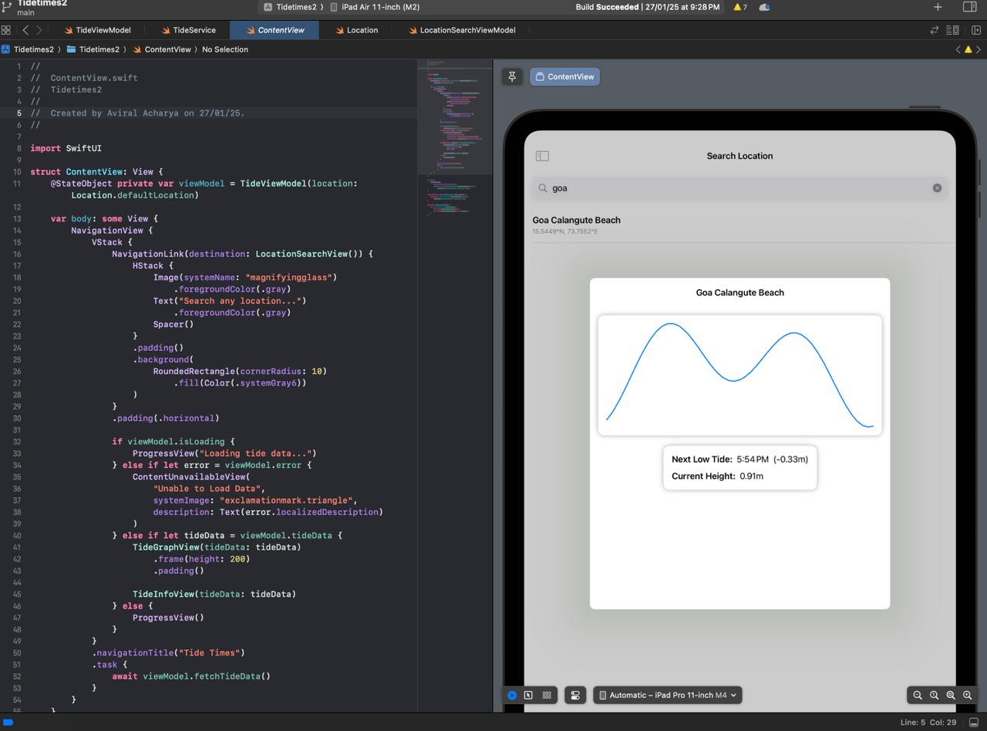
FINAL GRAPH AND COMPRISIONS
TIDE LEVELS FROM THE GOA PORT AND MUMBAI PORT

Slide 13
SCOPE
CORE FEATURES:
Real-Time Tide Predictions: Accurate tide times and heights for coastal locations.
AI-Driven Forecasting: Refined tide predictions based on historical data, weather conditions, and lunar cycles.
Weather Integration: Real-time weather conditions (wind, temperature) displayed alongside tide data.
User Location-Based Service: GPS-based tide predictions for users’ current location.
Custom Alerts: Users can set notifications for specific tide heights or times.
Target Audience:
Coastal Communities: People living near the coast who rely on tide data for daily activities.
Sailors & Boaters: Users who need reliable tide information for safe navigation.
Surfers & Water Sports Enthusiasts: Individuals who depend on tide predictions for surfing, kayaking, etc.

Slide 14
SCOPE WITH THEIR LIMITATIONS
Platform & Access:
Mobile App (iOS): Core functionality for iPhone and iPad users.
Web Access: Web version for desktop or browser-based access.
Cross-Device Sync: Sync settings and saved locations across devices for a seamless experience.
Non-Functional Aspects:
Performance: Real-time, low-latency data processing.
Security: Data protection and privacy compliance (GDPR, CCPA).
Future Features (Optional):
Smart Device Integration: Sync with wearables or smart speakers for tide updates.
Premium Subscription: Paid access to advanced features (e.g., AI-driven forecasts, historical data, ad-free experience).

Slide 15
FUTURE ENHANCEMENTS
Future Enhancements for Tide Times App
Augmented Reality (AR) Integration:
Tide Visualization: Use AR to overlay tide information over real-time camera feeds of coastal locations, helping users visually understand tide patterns and water levels.
2.Wearable Device Integration:
Smart Watches/Devices: Integrate with devices like Apple Watch to deliver tide updates and alerts directly to the user’s wearable.
Notifications via Wearables: Send real-time alerts (high/low tide, dangerous weather) to users' smartwatches or other connected
devices.
3.Advanced Machine Learning Features:
Personalized Tide Forecasts: Use AI to predict the best tide times for specific activities like fishing, surfing, or boating based on past user preferences and behaviors.
Predictive Alerts: Notify users about upcoming high/low tides, extreme weather events, or sudden changes in water conditions, allowing for proactive planning.
4.Advanced Data Analytics:
Historical Trends & Insights: Offer deeper analytics on tide trends, such as comparing data over months or years, and how factors like lunar cycles affect tides in different locations.

Slide 16
FUTURE ENHANCEMENTS
5.Integration with IoT Devices:
Smart Buoys: Collaborate with IoT-enabled buoys or sensors to collect and share real-time data on water conditions (wave height, temperature) that can be used for more accurate predictions.
Marine Equipment Integration: Sync the app with marine equipment (GPS devices, marine radios, etc.) for seamless data sharing and safety measures.
User Insights: Provide users with data on how their activities (surfing, boating, etc.) align with optimal tidal conditions over time.
6.Enhanced Web Version:
Interactive Map: Create an interactive map of global coastal regions where users can easily check tide data for different locations, zooming in to specific spots for detailed information.
Tide Graphs & Analytics: Display advanced graphical representations of tide patterns, trends, and comparisons across multiple locations on the website.
7.Monetization Options:
Freemium Model: Offer free basic features, with premium access to advanced forecasting, historical data, and ad-free experiences.
Advertisement: Introduce targeted ads relevant to coastal activities (e.g., surfboards, marine safety gear).
Partnerships with Businesses: Collaborate with marine equipment stores, surf schools, or local tourism businesses to provide in-app promotions or offers4
8.Multilingual Support:
International Expansion: Add support for multiple languages to cater to users from different regions and countries.
Localized Tide Information: Provide local tide data in formats specific to different cultures or regions.

Slide 17
CONCLUSION
TIDE TIMES aims to revolutionize coastal planning by providing accurate, AI-driven tide predictions, real-time weather integration, and a user-friendly experience for marine enthusiasts, ensuring safer and more efficient activities on the water.

Slide 18
GITHUB LINK
https://github.com/Aviral-Acharya/Tidetimes-

